Slide 1
Customer Feedback Analysis
Database Insights
and
Recommendations

Slide 2
Database Design Overview
Three tables for feedback: SurveyFeedback, WebFeedback, ExternalReviews
All contain customer_id, rating, and comments
SurveyFeedback includes name, email, region, and review_date
No foreign keys, but logically joined by customer_id
Data collected from CSV, JSON, and XML sources

Slide 3
Schemas
Table Name | Attribute Name | Data Type | Key Type
SurveyFeedback | customer_id | INT | /
 | name | NVARCHAR(100) | /
 | email | NVARCHAR(100) | /
 | region | NVARCHAR(50) | /
 | rating | INT | /
 | comments | NVARCHAR(255) | /
 | review_date | DATE | /

Slide 4
Schemas
WebFeedback | customer_id | INT | /
 | rating | INT | /
 | comments | NVARCHAR(255) | /
ExternalReviews | customer_id | INT | /
 | rating | INT | /
 | comments | NVARCHAR(255) | /

Slide 5
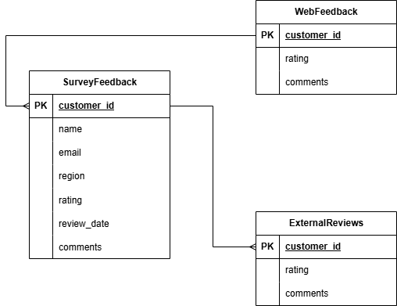
ER Diagram

Slide 6
Sentiment Analysis Insights
Positive: Ratings ≥ 4
Neutral: Rating = 3
Negative: Ratings < 3
Findings:
Most reviews are positive
Negative feedback often mentions delivery issues or product quality
Sentiment tagging helps in prioritizing customer concerns

Slide 7
Complaint Trends (Keywords)
Top complaint keywords across all feedback sources:
damaged: product received in poor condition
Late: shipping or delivery delays
defective: product not functioning as expected
Actionable Insight:
Focus on improving shipping reliability and packaging quality

Slide 8
Recommendations for Product Improvement
Address common complaints ('damaged', 'late') with better logistics
Monitor trends using regular sentiment and keyword analysis
Introduce a central Products table for category-level analysis
Enrich feedback with product_id and category fields for deeper insight
Improve data collection to increase volume and diversity

